Slide 1



chapter 9
evaluation techniques

Slide 2
Evaluation Techniques
Evaluation
  tests usability and functionality of system
  occurs in laboratory, field and/or in collaboration with users
  evaluates both design and implementation
  should be considered at all stages in the design life cycle

Slide 3
Goals of Evaluation
assess extent of system functionality
assess effect of interface on user
identify specific problems

Slide 4
Evaluating Designs
Cognitive Walkthrough
Heuristic Evaluation
Review-based evaluation

Slide 5
Cognitive Walkthrough
Proposed by Polson et al.
  evaluates design on how well it supports user in learning task
  usually performed by expert in cognitive psychology
  expert ‘walks though’ design to identify potential problems using psychological principles
  forms used to guide analysis

Slide 6
Cognitive Walkthrough (ctd)
For each task walkthrough considers
  what impact will interaction have on user?
  what cognitive processes are required?
  what learning problems may occur?
Analysis focuses on goals and knowledge: does the design lead the user to generate the correct goals?

Slide 7
Heuristic Evaluation
Proposed by Nielsen and Molich.
usability criteria (heuristics) are identified
design examined by experts to see if these are violated
Example heuristics
  system behaviour is predictable
  system behaviour is consistent
  feedback is provided
Heuristic evaluation `debugs' design.

Slide 8
0 = I don’t agree that this is a usability problem at all
1 = Cosmetic problem only: need not be ﬁxed unless extra time is available on project
2 = Minor usability problem: ﬁxing this should be given low priority
3 = Major usability problem: important to ﬁx, so should be given high priority
4 = Usability catastrophe: imperative to ﬁx this before product can be released (Nielsen)

Slide 9
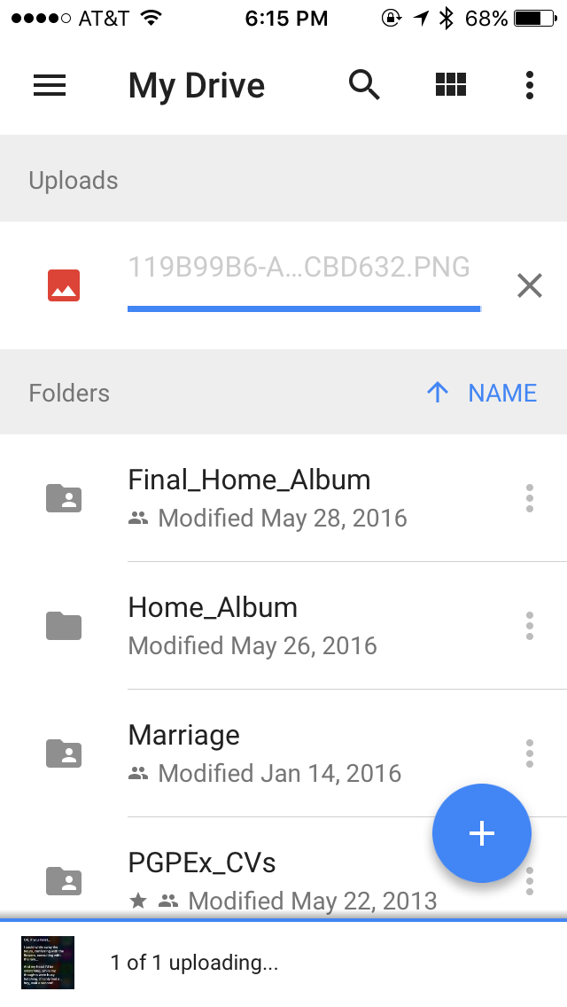
1. Visibility of the system status

Slide 10
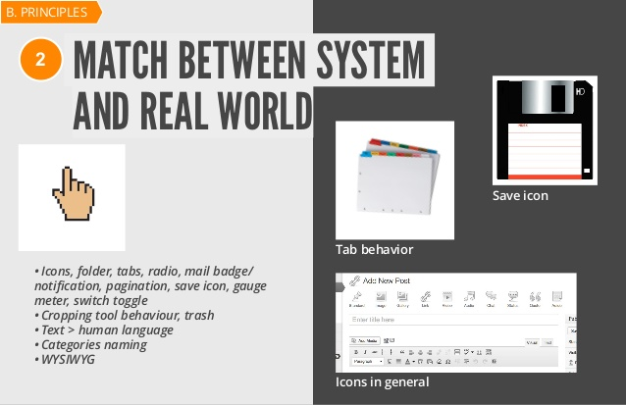
2. Match between system and the real world

Slide 11
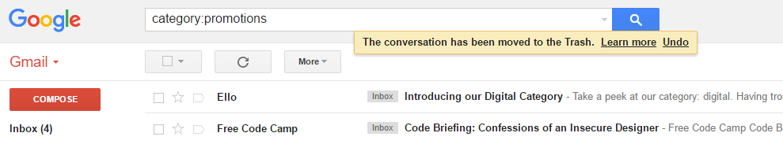
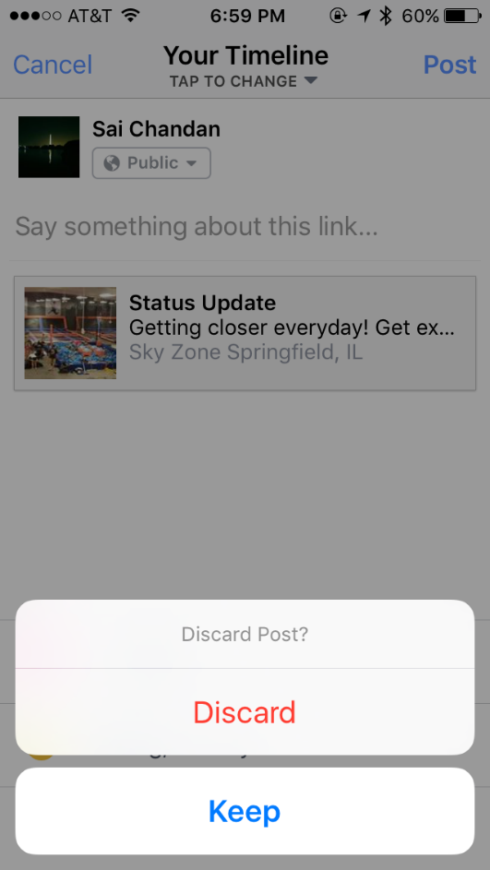
3.User Control and Freedom:

Slide 12
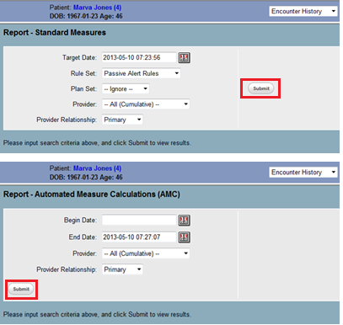
4. Consistency and standards

Slide 13

standards

Slide 14
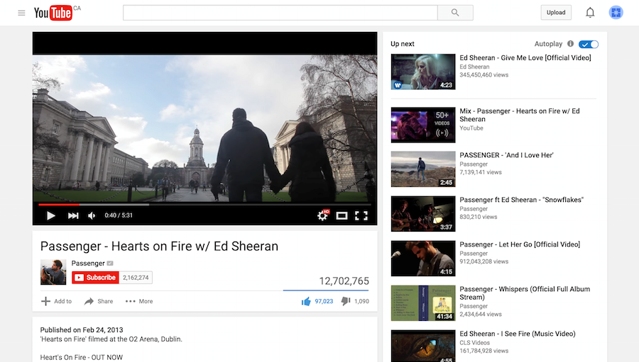
Design for user expectations

Slide 15
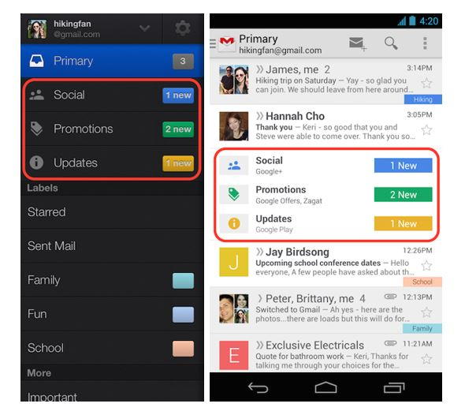
Bad example of consistency

Slide 16
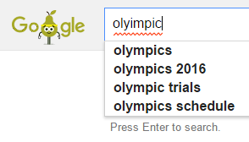
5. Error Prevention:

Slide 17
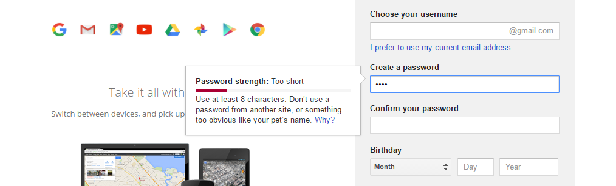
Continued…

Slide 18
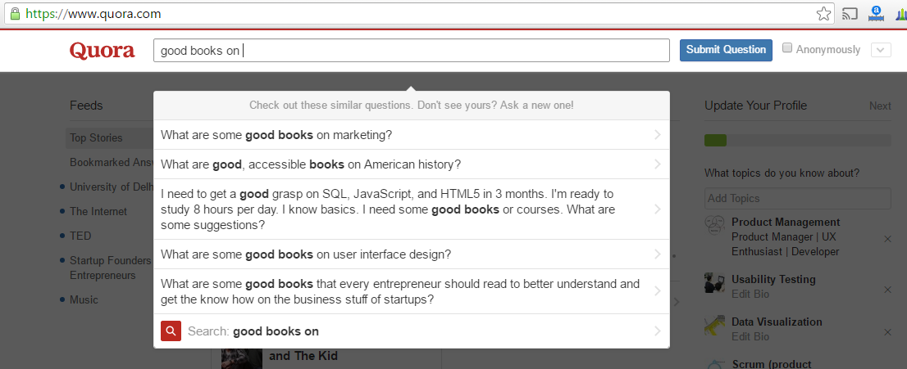
6. Recognition rather than recall:

Slide 19
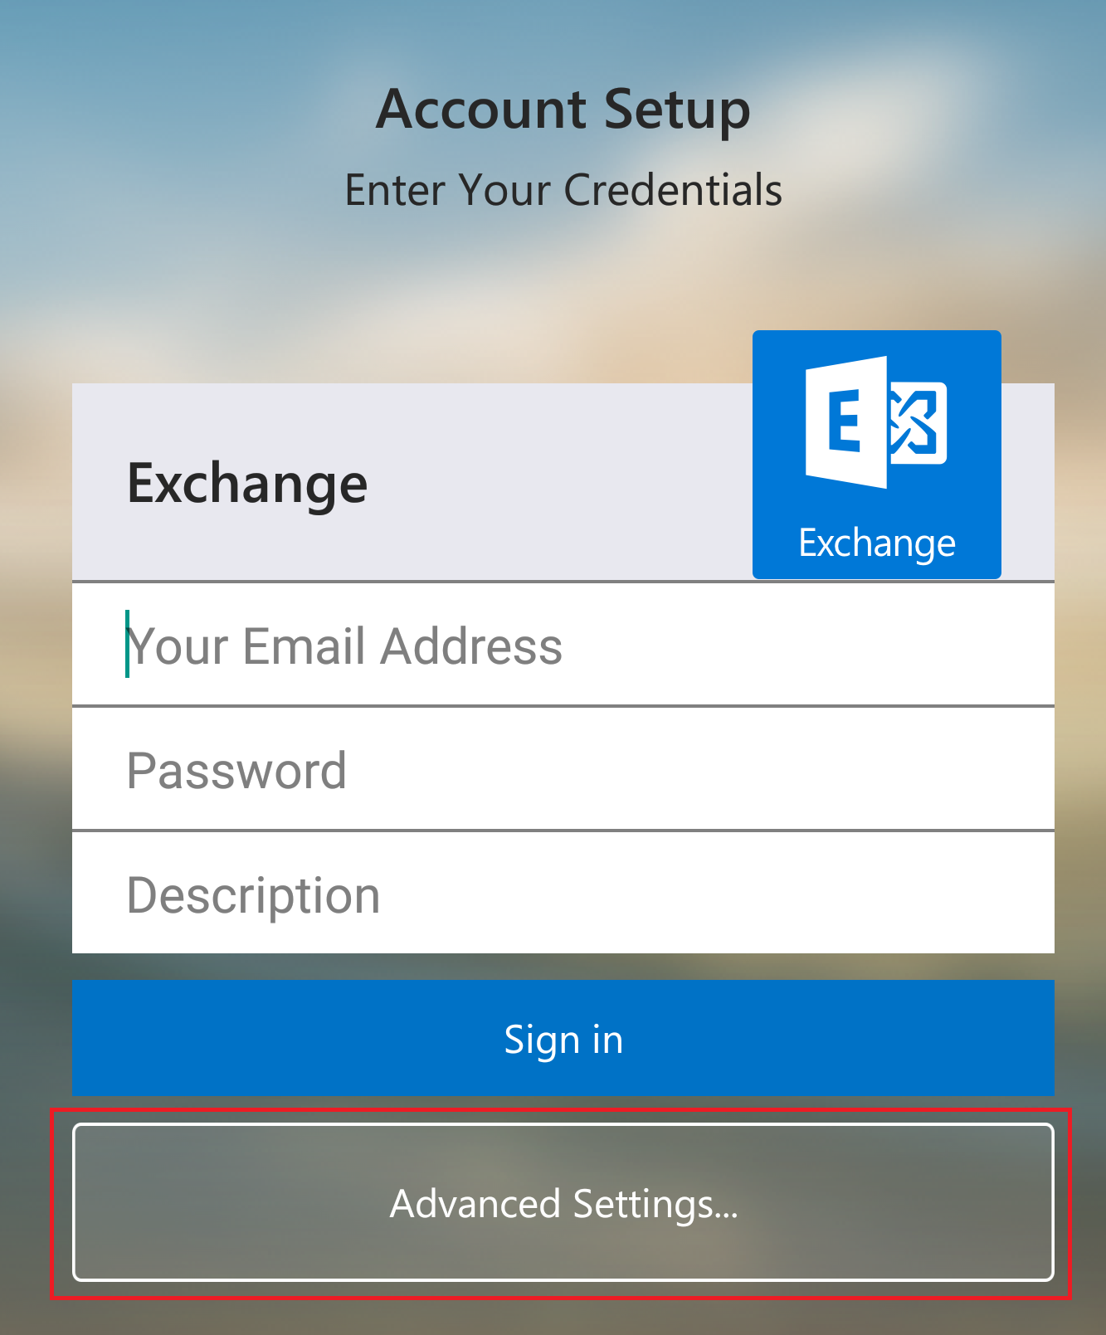
7. Flexibility and Efficiency of use:

Slide 20
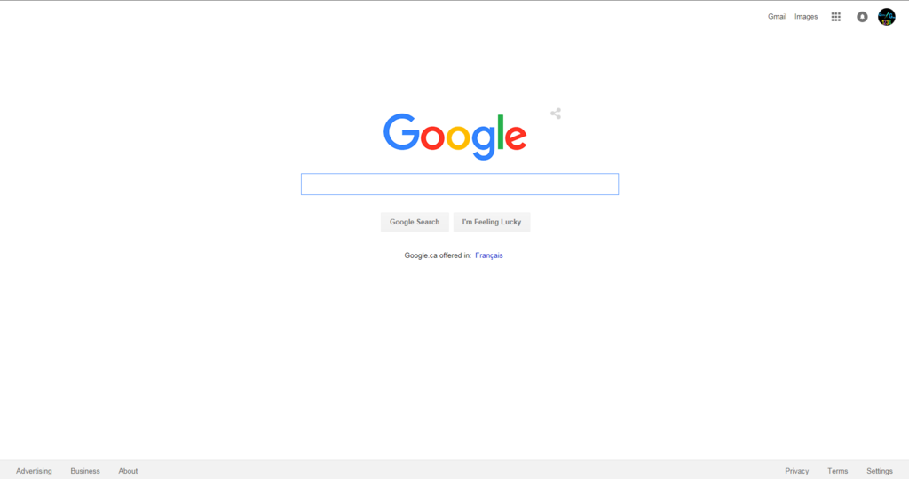
8. Aesthetic and minimalist design:

Slide 21
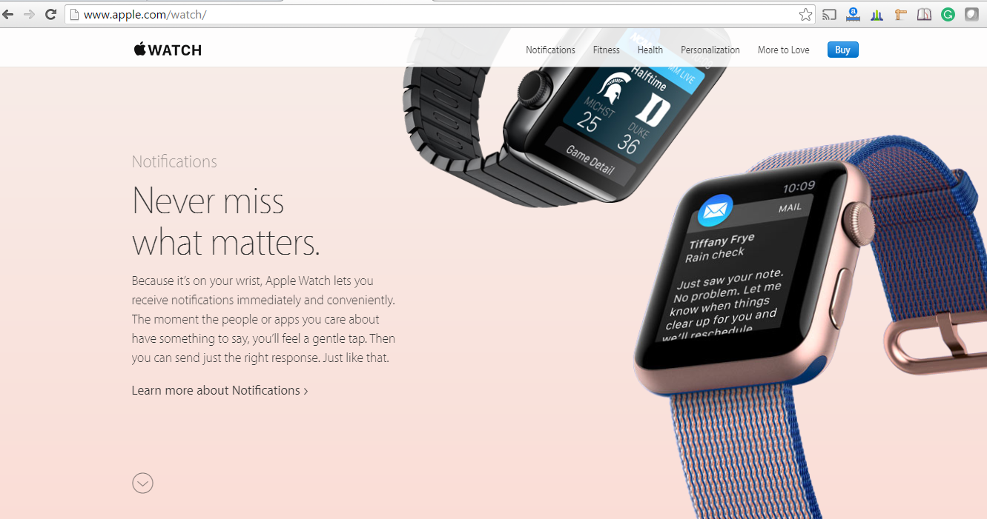
Continued…

Slide 22
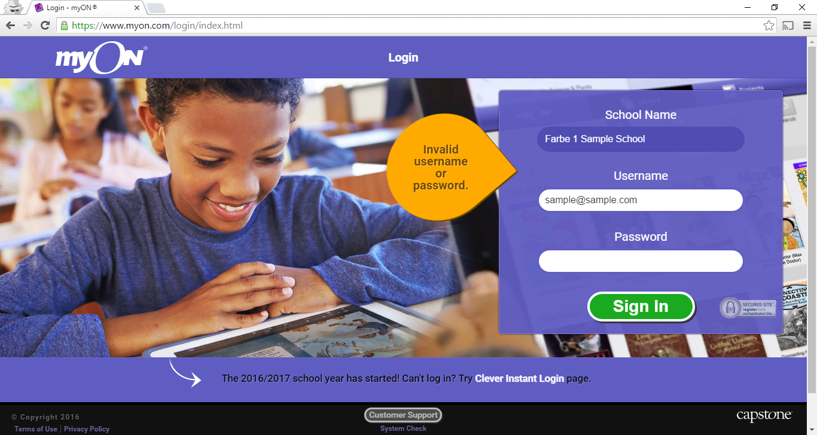
9. Help users recognize, diagnose, and recover from errors:

Slide 23
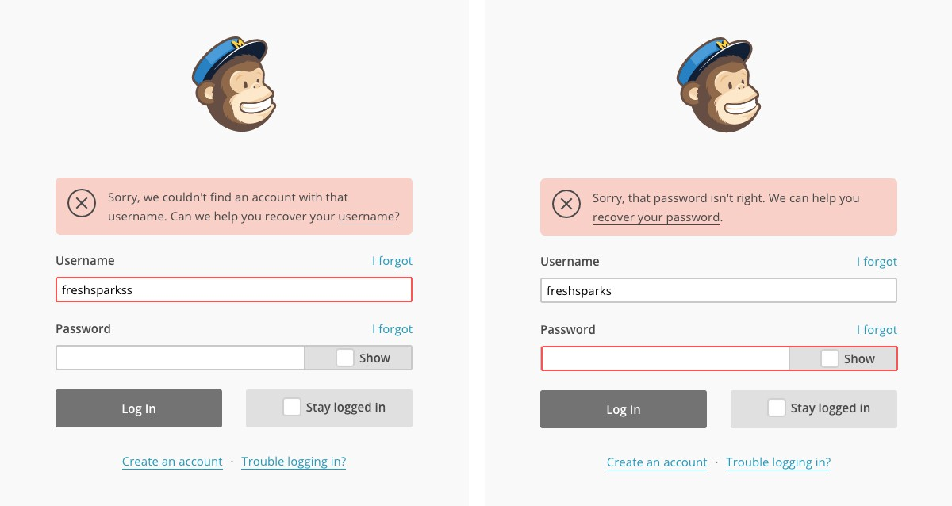

Slide 24
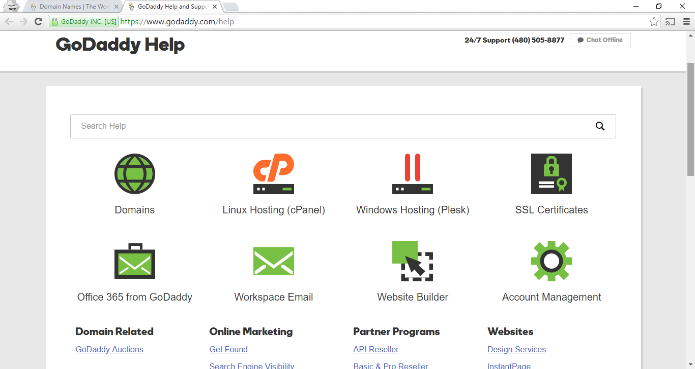
10. Help and documentation

Slide 25
Review-based evaluation
Results from the literature used to support or refute parts of design.
Care needed to ensure results are transferable to new design.
Model-based evaluation
Cognitive models used to filter design options
  e.g. GOMS prediction of user performance.
Design rationale can also provide useful evaluation information

Slide 26
Evaluating through user Participation

Slide 27
Laboratory studies
Advantages:
  specialist equipment available
  uninterrupted environment
Disadvantages:
  lack of context
  difficult to observe several users cooperating
Appropriate
  if system location is dangerous or impractical for constrained single user systems to allow controlled manipulation of use

Slide 28
Field Studies
Advantages:
  natural environment
  context retained (though observation may alter it)
  longitudinal studies possible
Disadvantages:
  distractions
  noise
Appropriate
  where context is crucial for longitudinal studies

Slide 29
Evaluating Implementations
Requires an artefact:
simulation, prototype,
full implementation

Slide 30
Experimental evaluation
controlled evaluation of specific aspects of interactive behaviour
evaluator chooses hypothesis to be tested
a number of experimental conditions are considered which differ only in the value of some controlled variable.
changes in behavioural measure are attributed to different conditions

Slide 31
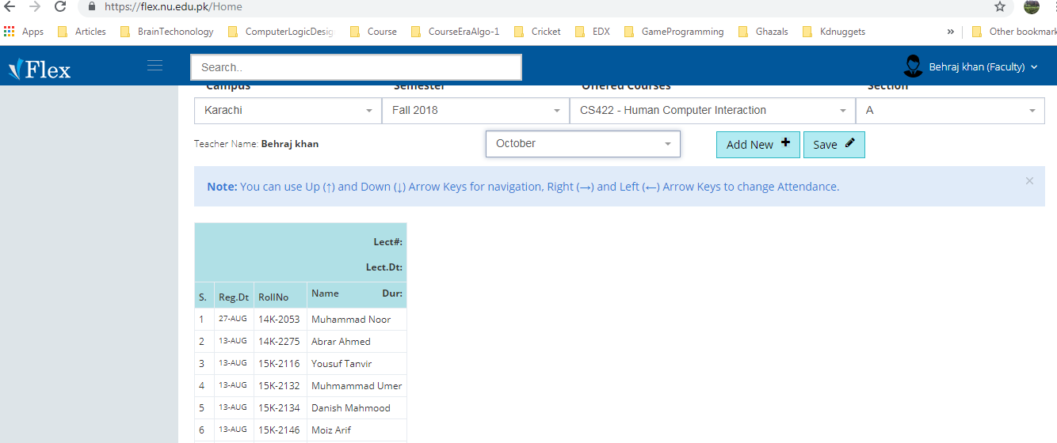

Slide 32
Experimental factors
Subjects
  who – representative, sufficient sample
Variables
  things to modify and measure
Hypothesis
  what you’d like to show
Experimental design
  how you are going to do it

Slide 33
Variables
independent variable (IV)
  characteristic changed to produce different conditions
  e.g. interface style, number of menu items
dependent variable (DV)
  characteristics measured in the experiment
  e.g. time taken, number of errors.

Slide 34
Hypothesis
prediction of outcome
  framed in terms of IV and DV
  e.g. “error rate will increase as font size decreases”
null hypothesis:
  states no difference between conditions
  aim is to disprove this
  e.g. null hyp. = “no change with font size”

Slide 35
Experimental design
within groups design
  each subject performs experiment under each condition.
  transfer of learning possible
  less costly and less likely to suffer from user variation.
between groups design
  each subject performs under only one condition
  no transfer of learning
  more users required
  variation can bias results.

Slide 36
Analysis of data
Before you start to do any statistics:
  look at data
  save original data
Choice of statistical technique depends on
  type of data
  information required
Type of data
  discrete - finite number of values
  continuous - any value

Slide 37
Analysis - types of test
parametric
  assume normal distribution
  robust
  powerful
non-parametric
  do not assume normal distribution
  less powerful
  more reliable
contingency table
  classify data by discrete attributes
  count number of data items in each group

Slide 38
Analysis of data (cont.)
What information is required?
  is there a difference?
  how big is the difference?
  how accurate is the estimate?
Parametric and non-parametric tests mainly address first of these

Slide 39
Experimental studies on groups
More difficult than single-user experiments
Problems with:
  subject groups
  choice of task
  data gathering
  analysis

Slide 40
Subject groups
larger number of subjects
⇒ more expensive
longer time to `settle down’
… even more variation!
difficult to timetable
so … often only three or four groups

Slide 41
The task
must encourage cooperation
perhaps involve multiple channels
options:
  creative task e.g. ‘write a short report on …’
  decision games e.g. desert survival task
  control task e.g. ARKola bottling plant

Slide 42
Data gathering
several video cameras
+ direct logging of application
problems:
  synchronisation
  sheer volume!
one solution:
  record from each perspective

Slide 43
Analysis
N.B. vast variation between groups
solutions:
  within groups experiments
  micro-analysis (e.g., gaps in speech)
  anecdotal and qualitative analysis
look at interactions between group and media
controlled experiments may `waste' resources!

Slide 44
Field studies
Experiments dominated by group formation
Field studies more realistic:
  distributed cognition ⇒ work studied in context
  real action is situated action
  physical and social environment both crucial
Contrast:
  psychology – controlled experiment
  sociology and anthropology – open study and rich data

Slide 45
Observational Methods
Think Aloud
Cooperative evaluation
Protocol analysis
Automated analysis
Post-task walkthroughs

Slide 46
Think Aloud
user observed performing task
user asked to describe what he is doing and why, what he thinks is happening etc.
Advantages
  simplicity - requires little expertise
  can provide useful insight
  can show how system is actually use
Disadvantages
  subjective
  selective
  act of describing may alter task performance

Slide 47
Cooperative evaluation
variation on think aloud
user collaborates in evaluation
both user and evaluator can ask each other questions throughout
Additional advantages
  less constrained and easier to use
  user is encouraged to criticize system
  clarification possible

Slide 48
Protocol analysis
paper and pencil – cheap, limited to writing speed
audio – good for think aloud, difficult to match with other protocols
video – accurate and realistic, needs special equipment, obtrusive
computer logging – automatic and unobtrusive, large amounts of data difficult to analyze
user notebooks – coarse and subjective, useful insights, good for longitudinal studies
Mixed use in practice.
audio/video transcription difficult and requires skill.
Some automatic support tools available
Notes:
Methods for recording user actions

Slide 49
automated analysis – EVA
Workplace project
Post task walkthrough
  user reacts on action after the event
  used to fill in intention
Advantages
  analyst has time to focus on relevant incidents
  avoid excessive interruption of task
Disadvantages
  lack of freshness
  may be post-hoc interpretation of events

Slide 50
post-task walkthroughs
transcript played back to participant for comment
  immediately → fresh in mind
  delayed → evaluator has time to identify questions
useful to identify reasons for actions and alternatives considered
necessary in cases where think aloud is not possible

Slide 51
Query Techniques
Interviews
Questionnaires

Slide 52
Interviews
analyst questions user on one-to -one basis
usually based on prepared questions
informal, subjective and relatively cheap
Advantages
  can be varied to suit context
  issues can be explored more fully
  can elicit user views and identify unanticipated problems
Disadvantages
  very subjective
  time consuming

Slide 53
Questionnaires
Set of fixed questions given to users
Advantages
  quick and reaches large user group
  can be analyzed more rigorously
Disadvantages
  less flexible
  less probing

Slide 54
Questionnaires (ctd)
Need careful design
  what information is required?
  how are answers to be analyzed?
Styles of question
  general
  open-ended
  scalar
  multi-choice
  ranked

Slide 55
Physiological methods
Eye tracking
Physiological measurement

Slide 56
eye tracking
head or desk mounted equipment tracks the position of the eye
eye movement reflects the amount of cognitive processing a display requires
measurements include
  fixations: eye maintains stable position. Number and duration indicate level of difficulty with display
  saccades: rapid eye movement from one point of interest to another
  scan paths: moving straight to a target with a short fixation at the target is optimal

Slide 57
physiological measurements
emotional response linked to physical changes
these may help determine a user’s reaction to an interface
measurements include:
  heart activity, including blood pressure, volume and pulse.
  activity of sweat glands: Galvanic Skin Response (GSR)
  electrical activity in muscle: electromyogram (EMG)
  electrical activity in brain: electroencephalogram (EEG)
some difficulty in interpreting these physiological responses - more research needed

Slide 58
Choosing an Evaluation Method
when in process: design vs. implementation
style of evaluation: laboratory vs. field
how objective: subjective vs. objective
type of measures: qualitative vs. quantitative
level of information: high level vs. low level
level of interference: obtrusive vs. unobtrusive
resources available: time, subjects,
equipment, expertise

